Slide 1
Computer Graphics –Lect 03
Graphics Output Primitives
Chapter – 3 of Hearn & Baker using OPENGL

Slide 2
Scan Conversion
Definition
It is the responsibility of the graphics system or the application program to convert each primitive from its geometric definition into a set of pixels that make up the primitive in image space. This conversion task is generally referred to as Scan Conversion / Rasterization.

Slide 3
Definition
Many pictures from 2D drawing to projected views of 3D objects consist of graphical primitives such as lines, points, circles and filled polygons.
These picture components are often defined in continuous space at a higher level of abstraction than individual pixels in the discrete image space.
For instance, a line is defined by 2 end points
and its line equation, where as a circle is defined by its radius center position and the circle equation.

Slide 4
Basics
Pixel : Little rectangles with same size and shape at each screen points
Image: Is a rectangular grid or array of pixels.

Slide 5
Output Primitives
The simplest form of output primitives are:
Points
Straight Lines
These primitives are defined in the graphics library, Opengl.

Slide 6
Points
Accomplished by converting a single coordinate position by an application program into appropriate operations for output device in use (i.e. monitor)
Electron beam is turned on to illuminate the screen phosphor depending on the display technology (Random-scan/Raster-scan)

Slide 7
Point
In OpenGL, the point is referred as vertex and is specified using command
        glVertex()
        GL_POINTS
Coordinates (x,y,z)
type

Slide 8
glVertex* ( )
* represents suffix codes
1st – 2,3,4 –dimensionality of a cordinate position
2nd – data type- i, s , f, d
3rd – if array specification is used – v
Note : Use the above between
glBegin( ); and glEnd( );

Slide 9
Example – array specification
int point1 [ ] = {50,100};
int point2 [ ] = {75,150};
int point3 [ ] = {100,200};
To plot them, we use
glBegin(GL_POINTS);
  glVertex2iv (point1);
  glVertex2iv (point2);
  glVertex2iv (point3);
glEnd( );

Slide 10
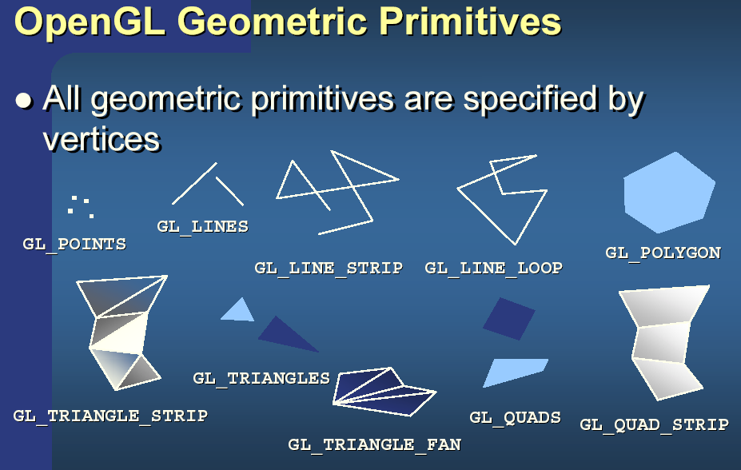
OpenGL Output Primitives

Slide 11
Why Lines?
Lines
  most common 2D primitive - done 100s or 1000s of times each frame
  even 3D wireframes are eventually 2D lines!
  optimized algorithms contain numerous tricks/techniques that help in designing more advanced algorithms

Slide 12
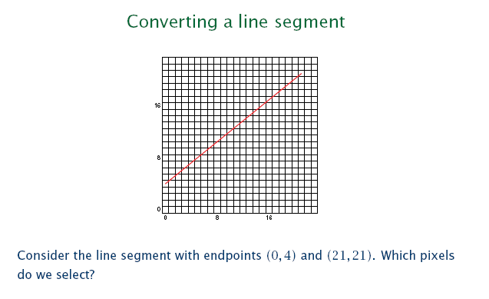
Scan conversion of Line

Slide 13
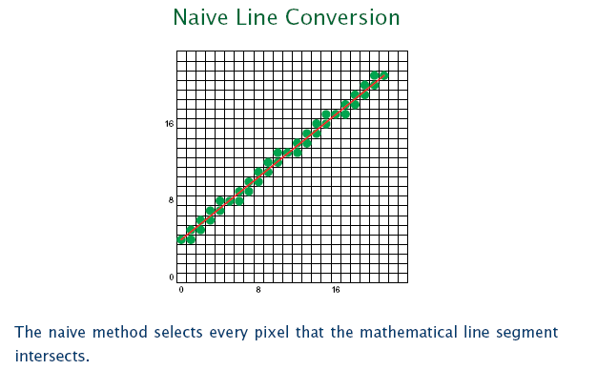
Lines

Slide 14
Line Requirements
Must compute integer coordinates of pixels which lie on or near a line or circle.
Pixel level algorithms are invoked hundreds or thousands of times when an image is created or modified – Hence it must be fast!
Lines must create visually satisfactory images.
  Lines should appear straight
  Lines should terminate accurately
  Lines should have constant density
Line algorithm should always be defined.

Slide 15
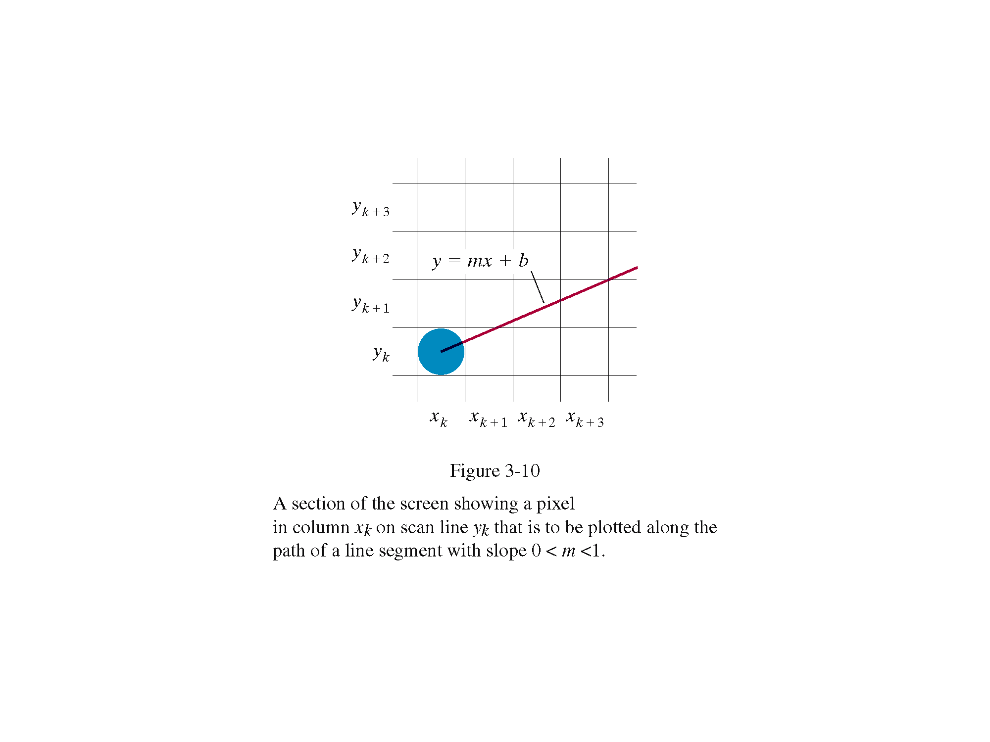

Slide 16
Basic Line Equation
Given two points
P1=(X₁,Y₁), P2=(X₂, Y₂)
Consider a third point on the
line: P = (X,Y)
Y = [(Y₂-Y₁)/(X₂-X₁)]*(X-X₁)+ Y₁
or
Y = mx + b
Cartesian Coordinate System
6
P = (X,Y)
5
4
P2 = (X2,Y2)
3
2
1
P1 = (X1,Y1)
1
2
3
4
5
6
SLOPE =
RISE
Y2-Y1
=
RUN
X2-X1

Slide 17
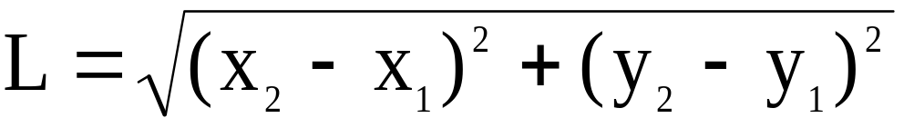
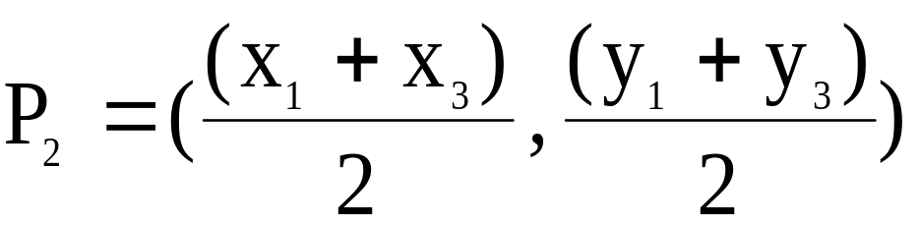
Other Helpful Formulas
Length of line segment between P₁ and P₂:
Midpoint of a line segment between P₁ and P₃:
Two lines are perpendicular iff
1) M₁ = -1/M₂
2) Cosine of the angle between them is 0.

Slide 18
Parametric Form
Given points P₁ = (X₁, Y₁) and P₂ = (X₂, Y₂)
X = X₁ + t(X₂-X₁)
Y = Y₁ + t(Y₂-Y₁)
We get all the other points on the line segment between (X₁,Y₁) and (X₂,Y₂) as 0 < t < 1

Slide 19
Line Algorithms
1. DDA Line Algorithm
2. Bresenham Line Algorithm

Slide 20
Basic Line Equation y=mx+b
. m = slope
. m is the changes in y divided by changes of x
. m = Δy / Δx
. b = the point where the line intercepts of y axis.
. Line from (x1,y1) to (x2,y2)
. Slope
. m = Δy /Δx
. Δy = y2-y1
. Δx = x2-x1
. m = y2-y1/x2-x1
. y axis Intercept
. b = y1 – m.x1

Slide 21
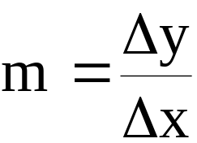
DDA Line Algorithm
The digital differential analyzer (DDA) is a scan-conversion line algorithm based on calculating either Δy or Δx where
        Δy = y₂-y₁
        Δx = x₂-x₁
For lines with a slope m greater than 1
        X_{k+1} = X_{k} +1/m ( How ???)
For lines with a slope m less than or equal to 1
Y_{k+1} = Y_{k} + m ( How ???)

Slide 22
DDA Code
#include <stdlib.h>
#include <math.h>
inline int round (const float a) { return int (a+0.5) ; }
void lineDDA( int x0, int y0, int xend, int yend)
{ int dx = xend-x0, dy = yend – y0, steps, k;
float xinc, yinc, x = x0, y = y0;
if (fabs(dx) > fabs(dy))
steps = abs(dx);
else
steps = fabs(dy);
xinc = float (dx) / float steps;
yinc = float (dy) / float steps;
setPixel(round(x), round(y));
for (k=0; k<steps; k++)
{
x += xinc;
y+= yinc;
setPixel(round(x), round(y));
}
}
DDA create good lines but it is too time consuming due to the round function and long operation on real values

Slide 23
Conditions
When |m|<=1, set Δx =1 and calculate y from Y_{k+1} = Y_{k} + m
For |m|>1, Δy =1 and calculate x from X_{k+1} = X_{k} + 1/m

Slide 24
DDA Example
Compute which pixels should be turned on to represent the line from (6,9) to (11,12).
step = ?
xinc = ?
yinc = ?
13
12
11
10
9
6
7
8
9
10
11
12
13

Slide 25
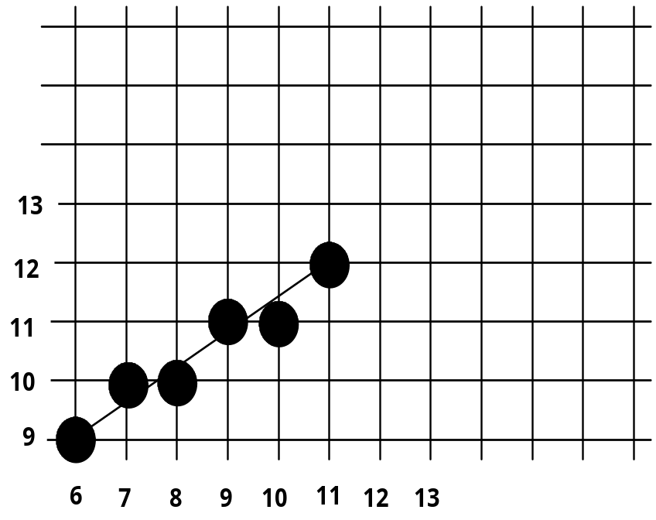
DDA Example
Line from (6,9) to (11,12).
step := Max of (ABS(11-6), ABS(12-9)) = 5
Xinc := 1
Yinc := 0.6
Values computed are:
(6,9), (7,9.6),
(8,10.2), (9,10.8),
(10,11.4), (11,12)

Slide 26
DDA
. Advantages:
. Faster than using y = mx +b
. Eliminates multiplication (mx) by using screen characteristics, i.e. incrementing pixel.
. Disadvantages:
. Floating point arithmetic is slower than integer arithmetic.
. Rounding down takes time.
. Long lines can drift from the true line due to floating point round-off errors.

Slide 27
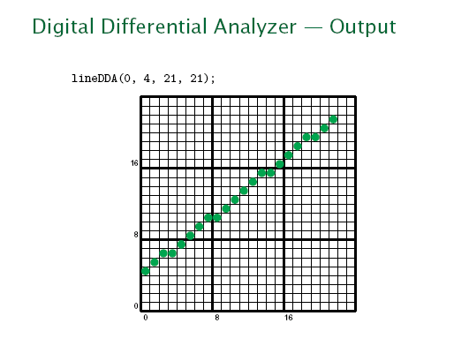
DDA

Slide 28
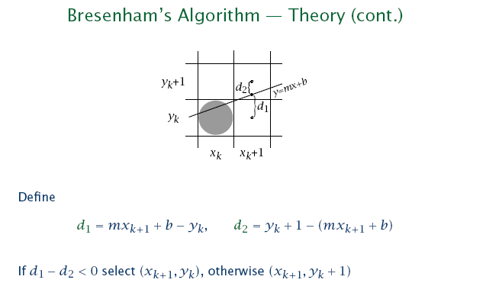
Bresenham’s Line Drawing Algorithm

Slide 29
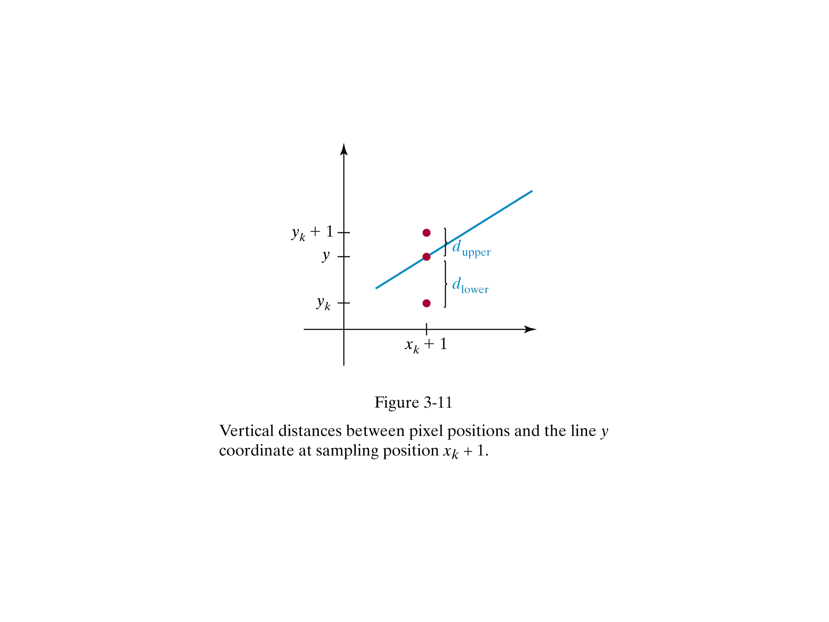

Slide 30
Bresenham’s Line Drawing Algorithm
1. Input the two line endpoints and store the left endpoint in (X₀,Y₀)
2. Load (X₀,Y₀) into the frame buffer; that is, plot the first point.
3. Calculate constants ΔX, ΔY, 2ΔY, and 2ΔY - 2ΔX, and obtain the starting value for the decision parameter P₀ as
      P₀ = 2ΔY - ΔX
4. At each X_{k} along the line, starting at k = 0, perform the following test:
If P_{k} < 0, the next point to plot is (X_{k} + 1, Y_{k}) and
P_{k+1} = P_{k} + 2ΔY
Otherwise, the next point to plot is (X_{k} + 1, Y_{k} + 1) and
P_{k+1} = P_{k} + 2ΔY - 2ΔX
5. Repeat step 4, ΔX times.

Slide 31
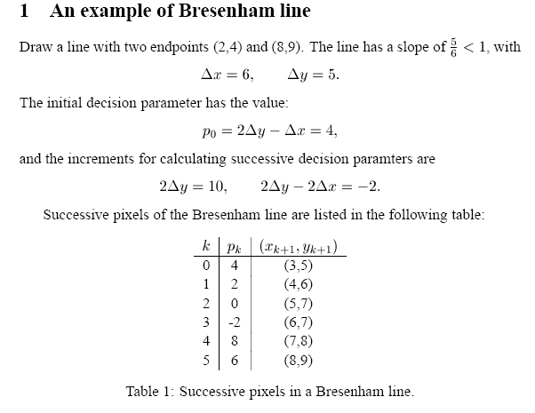

Slide 32
Bresenham’s Line Algorithm
#include <stdlib.h>
#include <math.h>
/* Bresenham line-drawing procedure for |m| < 1.0. */
void lineBres (int x0, int y0, int xEnd, int yEnd)
{
int dx = fabs (xEnd - x0), dy = fabs(yEnd - y0);
int p = 2 * dy - dx;
int twoDy = 2 * dy, twoDyMinusDx = 2 * (dy - dx);
int x, y;
/* Determine which endpoint to use as start position. */
if (x0 > xEnd) {
x = xEnd;
y = yEnd;
xEnd = x0;
}

Slide 33
Bresenham’s Line Algorithm
else {
x = x0;
y = y0;
}
setPixel (x, y);
while (x < xEnd) {
x++;
if (p < 0)
p += twoDy;
else {
y++;
p += twoDyMinusDx;
}
setPixel (x, y);
}
}

Slide 34
Try this
Scan convert a line with endpoints (20,10) and (30,18) using
Bresenham ‘s Line Algorithm

Slide 35
Solution
We digitize the line with endpoints (20,10) and (30,18)
ΔX= 10, ΔY = 8, 2ΔY = 16, 2ΔY - 2ΔX = -4
p₀ = 2ΔY - ΔX = 6
k | p_{k} | (x_{k+1},y_{k+1}) | k | p_{k} | (x_{k+1},y_{k+1})
0 | 6 | (21,11) | 5 | 6 | (26,15)
1 | 2 | (22,12) | 6 | 2 | (27,16)
2 | -2 | (23,12) | 7 | -2 | (28,16)
3 | 14 | (24,13) | 8 | 14 | (29,17)
4 | 10 | (25,14) | 9 | 10 | (30,18)

Slide 36
Bresenham
Advantages
. Accurate and efficient – incremental integer calculations
. Can be adapted to draw circles and curves.
Generalization:
Increment (x or y) depending on slope (m)
starting endpoints (left or right)

Slide 37
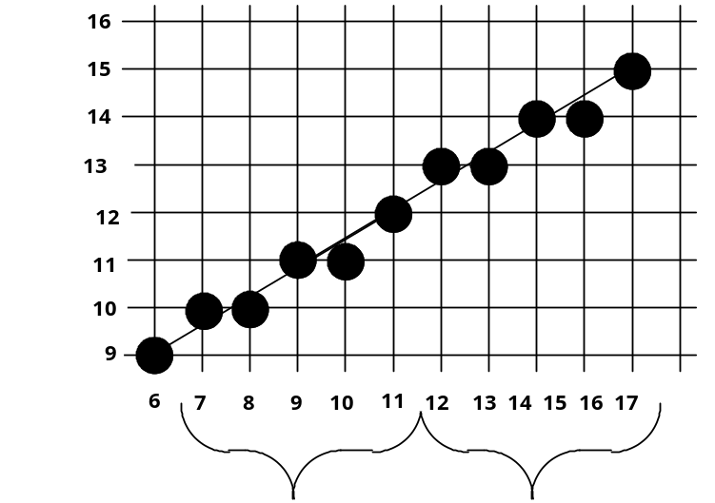
Optimizations
Speed can be increased even more by detecting cycles in the decision variable. These cycles correspond to a repeated pattern of pixel choices.
The pattern is saved and if a cycle is detected it is repeated without recalculating.
di= 2 -6 6 -2 10 2 -6 6 -2 10

Slide 38
Output Primitives (Contd..)
Three other output primitives:
1. Circles
2. Ellipses
3. Curves

Slide 39
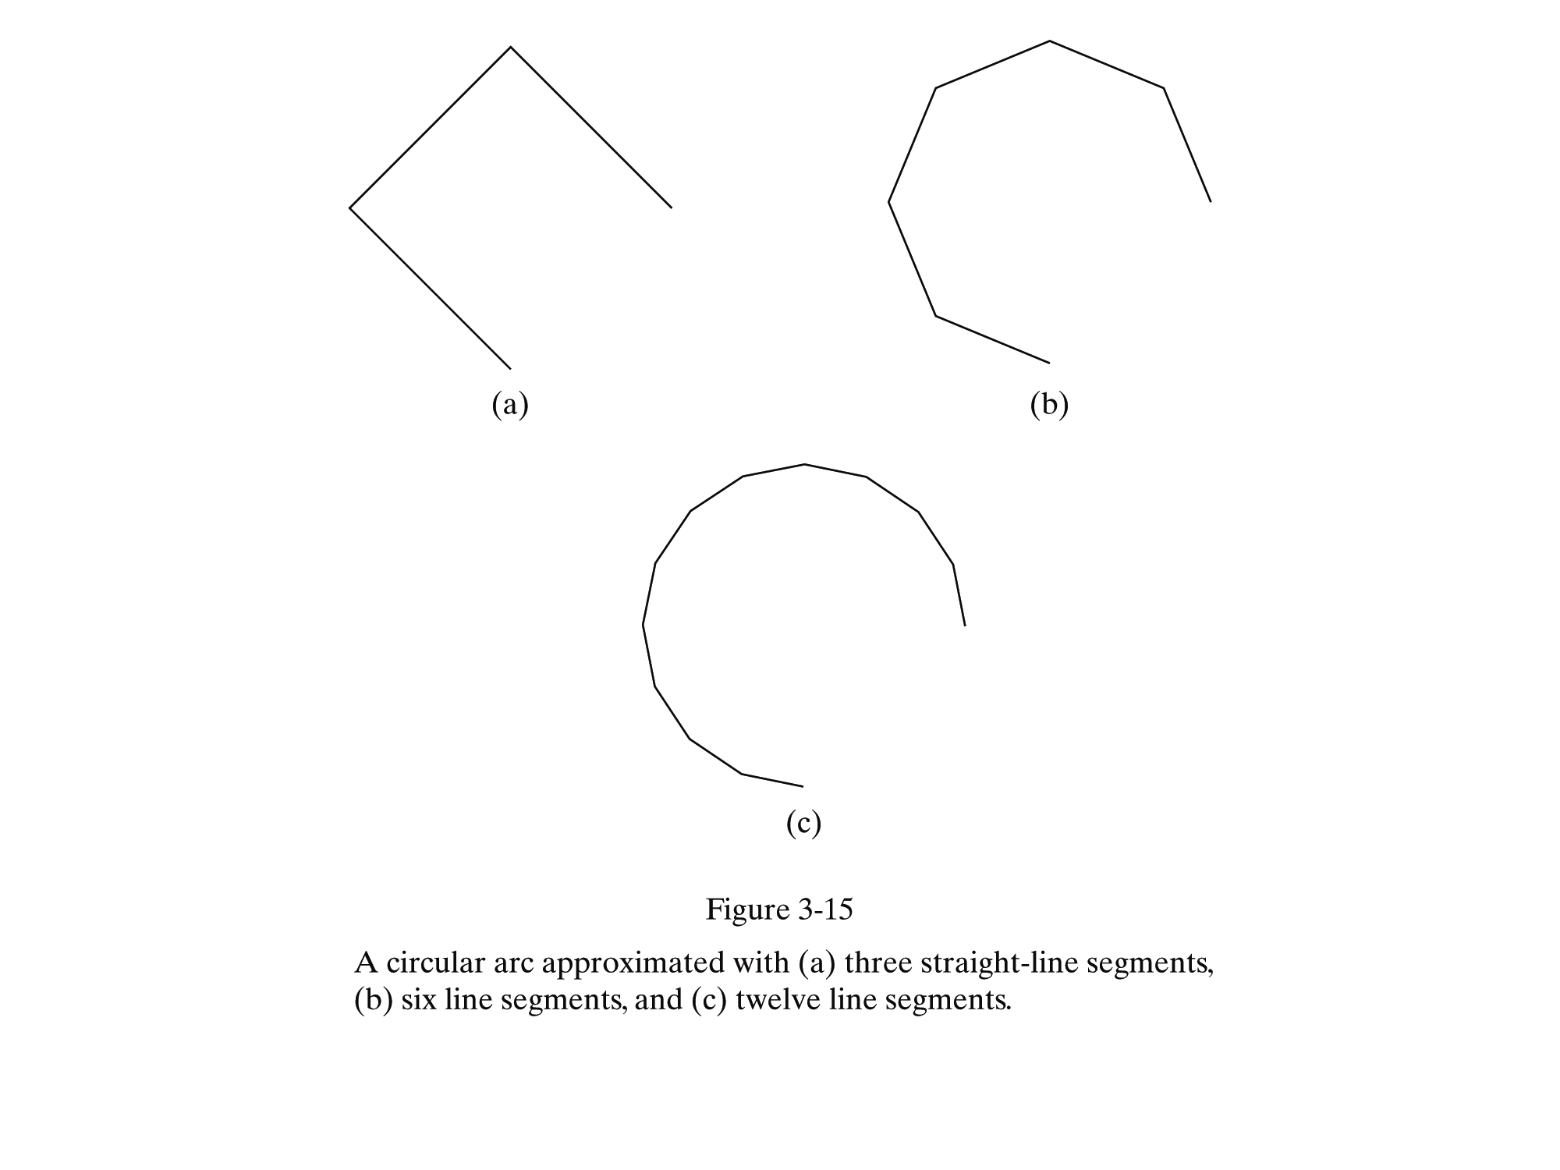

Slide 40
Circles
Properties:
1. Is a set of points from a given distance of r from center position (x_{C}, y_{C}).
2. Is divided into 4 quadrants and 8 octants .
3. Symmetrical Property of circle is used to reduce the number of calculations.

Slide 41
Circle Algorithms
1. Square Root Algorithm
2. Trigonometric Algorithm
3. Bresenham Mid-Point Algorithm

Slide 42
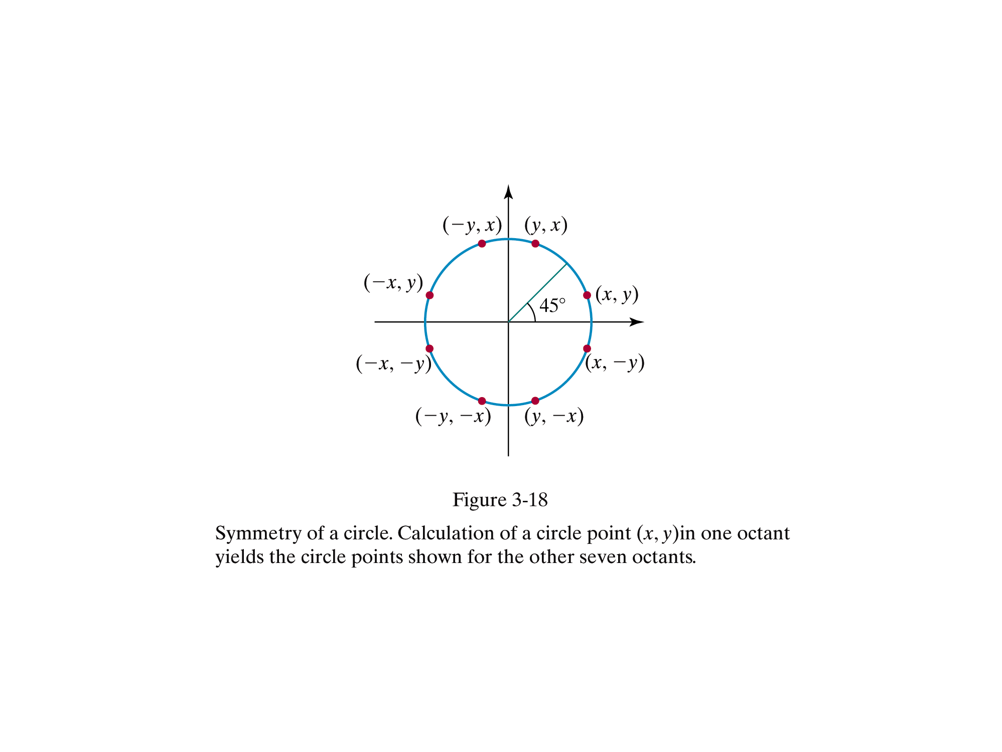

Slide 43
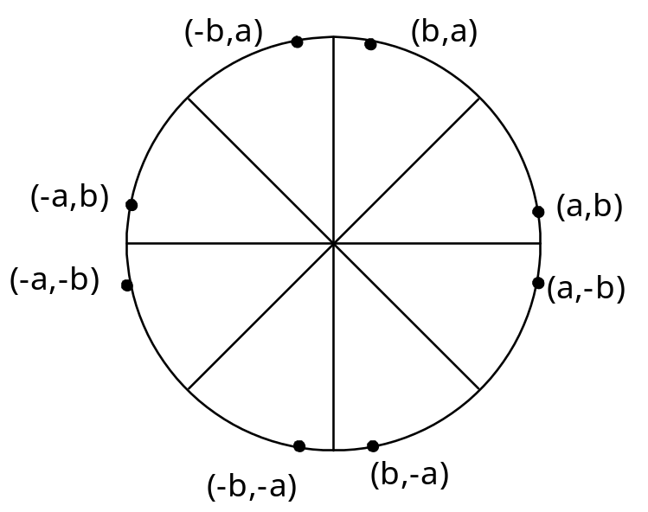
Circle Drawing by Symmetry
We only need to calculate the values on the border of the circle in the first octant. The other values may be determined by symmetry. Assume a circle of radius r with center at (0,0).
Procedure Circle_Points(a,b :Integer);
Begin
Plot(a,b);
Plot(b,a);
Plot(-b,a);
Plot(-a,b);
Plot(-a,-b);
Plot(-b,-a);
Plot(b,-a);
Plot(a,-b)
End;

Slide 44
Circles
1. Cartesion Co-ordinates. (Square root method)
Distance relationship expressed by the Pythagorean theorem in Cartesian coordinates as: (x-x_{c})² + (y-y_{c})² = r²
So, when stepping along the x axis in units intervals from x_{c}-r to x_{c}+ r and calculate the corresponding ‘y’ co-ordinate at each position as
y = y_{c} ±√r² – (x_{c}-x)²

Slide 45
Circles
Cartesion Co-ordinates. (Square root method)
. void circleSqrt(const int a, const int b, const int r) {
int i;
int r2 = r*r;
int x1, x2;
int y1, y2;
double y;
for(i = 0; i <= r; i++) {
y = sqrt((double) (r2 - i*i));
x1 = a + i;
x2 = a - i;
y1 = ROUND(b + y);
y2 = ROUND(b - y);
setPixel(x1, y1);
setPixel(x2, y1);
setPixel(x1, y2);
setPixel(x2, y2);}
return; }

Slide 46
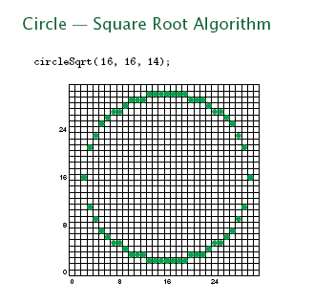
Circles

Slide 47
Circles
Cartesion Co-ordinates. (Square root method) (cont)
. Disadvantages
. Considerable amount of calculation (squares and square roots).
. Spacing between pixel is not uniform around the circle.
. Based on the upper octant (between y axis and 45º line), circles increases
faster along x axis compared to y axis. Since we are stepping along x axis,
pixels with successive x co-ordinate positions can have the same y co-ordinate
– reduce or no gap.
. In the lower octant , the circle increases faster along the y axis compared to x
axis. Pixels with successive y co-ordinates need to have the same x co-
ordinates to avoid gaps. Since , we are using x axis in unit of intervals, so each
pixel has a unique y-coordinates – bigger gap.

Slide 48
Circles
Cartesion Co-ordinates. (Square root method) (cont)
. Solutions:
- to change the logic or formula whether to y
or x depending on the upper or lower octant.
- use polar co-ordinates
Note: changing formula do requires more calculation.

Slide 49
Circles
2 Polar Co-ordinates (trigonometric functions)
. The equation of a circle is written in the polar co-ordinates r
and θ as
x = x_{c} + r.cosθ
y = y_{c} + r.sinθ
. x and y are the co-ordinates of a point on the circumference,
i.e the end point of a line drawn from the centre of the circle
to the circumference – the radius.

Slide 50
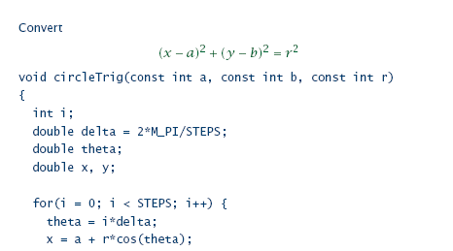
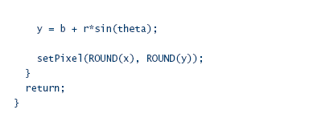
Circles
Polar Co-ordinates (trigonometric functions)

Slide 51
Circles
Polar Co-ordinates (trigonometric functions)
The calculation of x and y with polar co-ordinates calculates
the distance of x and y from the center of the circle.
θ is the step size.
A step size of θ = 1/r will produce a continuous circle with the pixel positions approximately 1 unit apart.
The larger of the step size will cause the straight lineconnection.
Disadvantages:
a. Trigonometric calculations (sin and cos) are computationally expensive.

Slide 52
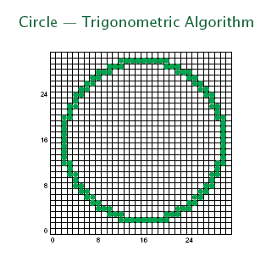
Circles
Polar Co-ordinates (trigonometric functions)

Slide 53
Bresenham Mid Point Algorithm
. To avoid rounding where incrementing integer for calculation is faster and more efficient.
. Center is not always at (0,0)
. In this algorithm, parameter P is used to determine the y co-ordinate of the next pixel to plot.
. Decision parameter P is based on circle function f that determines whether pixel is
. inside the boundary (f_{circle}(x,y) < 0 )
. on the circle boundary (f_{circle}(x,y) = 0 )
. outside the circle boundary (f_{circle}(x,y) > 0 )
where f_{circle}(x,y) = x² + y² – r²

Slide 54
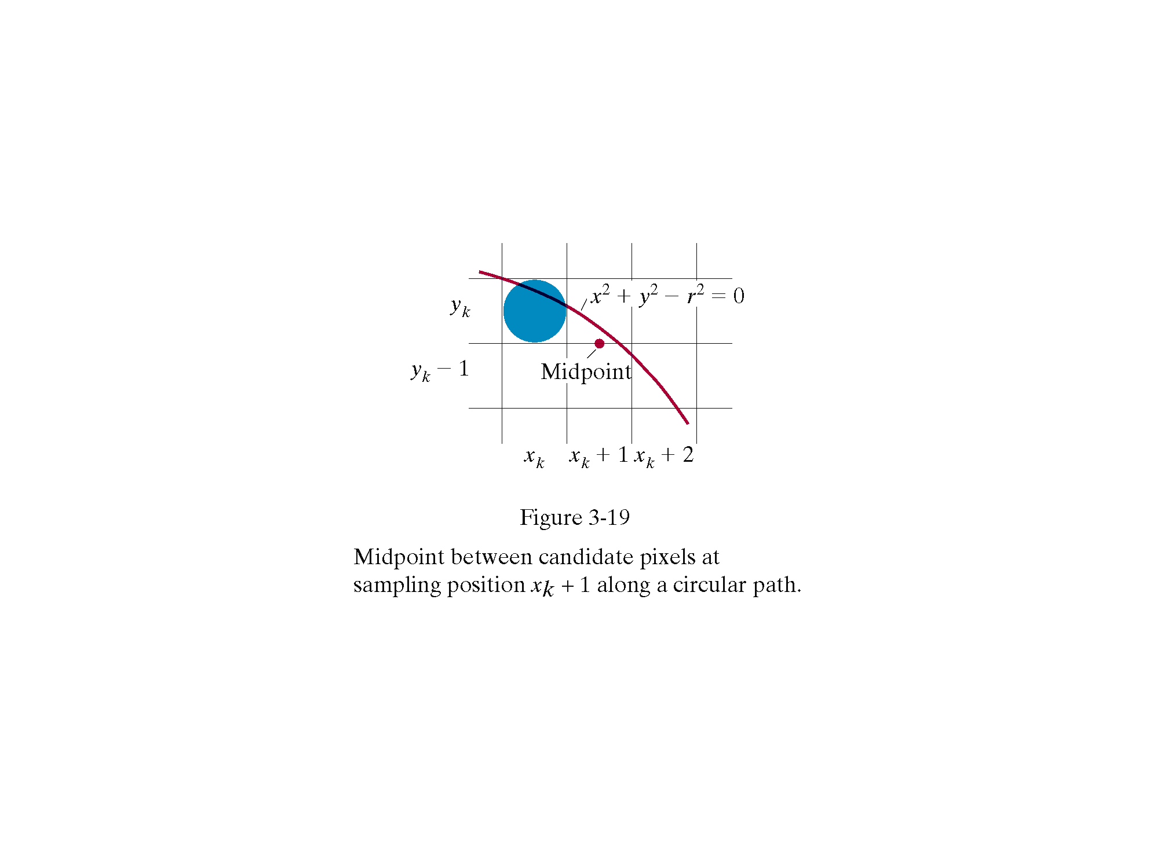

Slide 55
Bresenham Mid Point Algorithm
Bresenham Mid Point Circle Drawing Algorithm
Step along the x axis in unit intervals (k) from k=0 to k=r
Plot the first point (0,r)
From (0,r) then we need to decide whether to plot on (x_{k}+1,y_{k}) or (x_{k}+1, y_{k}-1)
The decision parameter P is the circle function evaluated at the mid-point between these two pixels.
P = f_{circle}(x_{k}+1,y_{k} – 0.5) = P₀ = 5/4 –r = 1-r if r is specified as integer.

Slide 56
Bresenham Mid Point Algorithm
Bresenham Algorithm (Mid Point)
. If P_{k} < 0
The mid-point is inside the boundary, so the pixel at (x_{k}+1,y_{k}) is closer to the circle boundary and should be plotted.
. P_{k+1} = P_{k}+2x_{k+1}+1
. If P_{k}= 0 or P_{k} > 0
The mid-point is outside or on the circle boundary. So the pixel at (x_{k}+1,y_{k}-1) is closer to the circle boundary and need to be plotted.
P_{k+1} = P_{k}+2x_{k+1}+1- 2y_{k+1}

Slide 57
Bresenham Mid Point Algorithm
Bresenham Algorithm (Mid Point) Contd…
Determine the symmetry points in the other seven octants.
Move each calculated pixel position(x,y) onto a circular path centered on(x_{c,} y_{c}) and plot the co-ordinate values : x = x+x_{c} and y=y+y_{c}
Repeat the above steps until x>=y.

Slide 58
Try this
Draw a circle with radus r= 8 and centering at (0,0) using Bresenham MidPoint Circle Drawing Algorithm

Slide 59
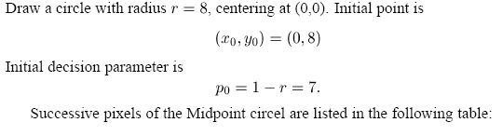
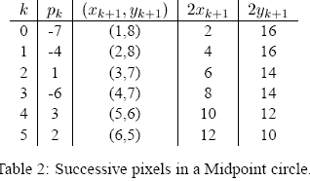
Solution

Slide 60
Try this
Modify the radius in the above r=10 and get the pixel points using Bresenham Midpoint circle algorithm.

Slide 61
Sol
Corresponding set of pixels are: (0,10)
(1,10), (2,10), (3,10), (4,9), (5,9), (6,8) and (7,7)

Slide 62
Bresenham MidpointCircle Algorithm
Void circleMidpoint (int xcenter, int ycenter, int radius)
{ int x=0;
int y=radius;
int p=1-radius;
void circlePlotPoints (int , int, int, int);
/* Plot first set of points */
circlePlotPoints (xCenter, yCenter, x,y);
while (x<y) { x++;
if (p<0)
p +=2* x + 1;
else {
y--;
p += 2 * (x-y) + 1;}
circlePlotPoints (xCenter, yCenter, x, y); }
}
void circlePlotPoints (int xCenter, int yCenter, int x, int y)
{ setPixel (xCenter + x, yCenter + y);
setPixel (xCenter - x, yCenter + y);
setPixel (xCenter + x, yCenter - y);
setPixel (xCenter - x, yCenter - y);
setPixel (xCenter + y, yCenter + x);
setPixel (xCenter - y, yCenter + x);
setPixel (xCenter + y, yCenter - x);
setPixel (xCenter - y, yCenter -x); }

Slide 63
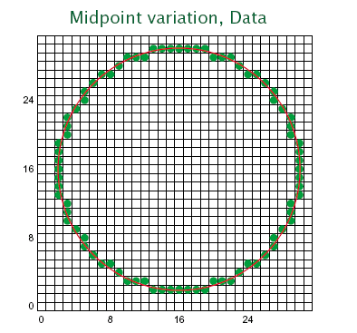
Mid Point Circle Algorithm

Slide 64
Ellipses
. An ellipses is an elongated circle and can be drawn with modified circle drawing algorithm.
. An ellipse has set of fixed points (foci) that will have a constant total of distance from all the points on the boundary.
. An ellipse has 2 axes
. Major: straight line running through the two foci
and the long axis.
. Minor: straight line running through the centre that bisects
the major axis – the short axis.

Slide 65
Ellipses
.Ellipse symmetry
. Ellipses are symmetrical between the four quadrants.
. Ellipses drawing algorithm only need to calculate the pixels
for one quadrant.
The general ellipse algorithm in Cartesian co-ordinates is
(x-x_{c}/r_{x})² + (y-y_{c}/r_{y})² = 1
In polar co-ordinates ,
x = x_{c} + r_{x} cos θ
y = y_{c} + r_{y} sin θ
.As for circles, algorithms that use Cartesian or polar co
ordinates are computationally expensive.

Slide 66
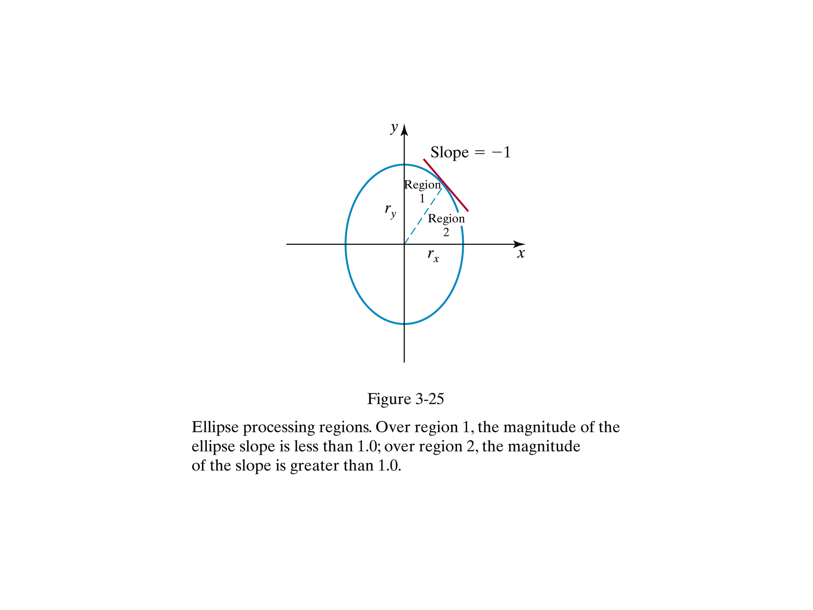

Slide 67
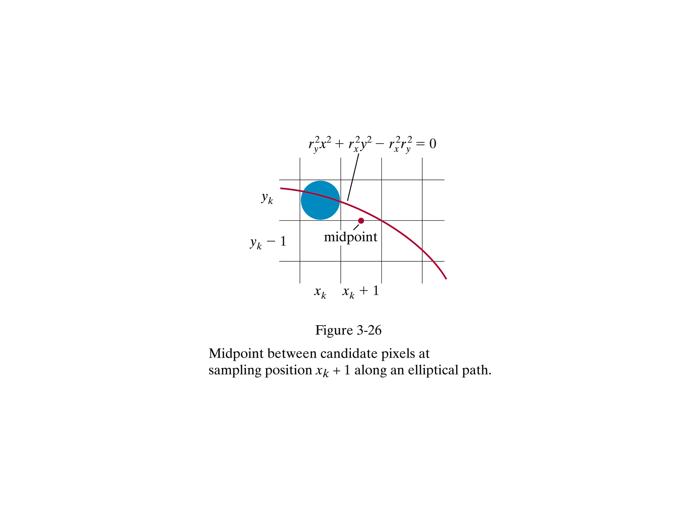

Slide 68
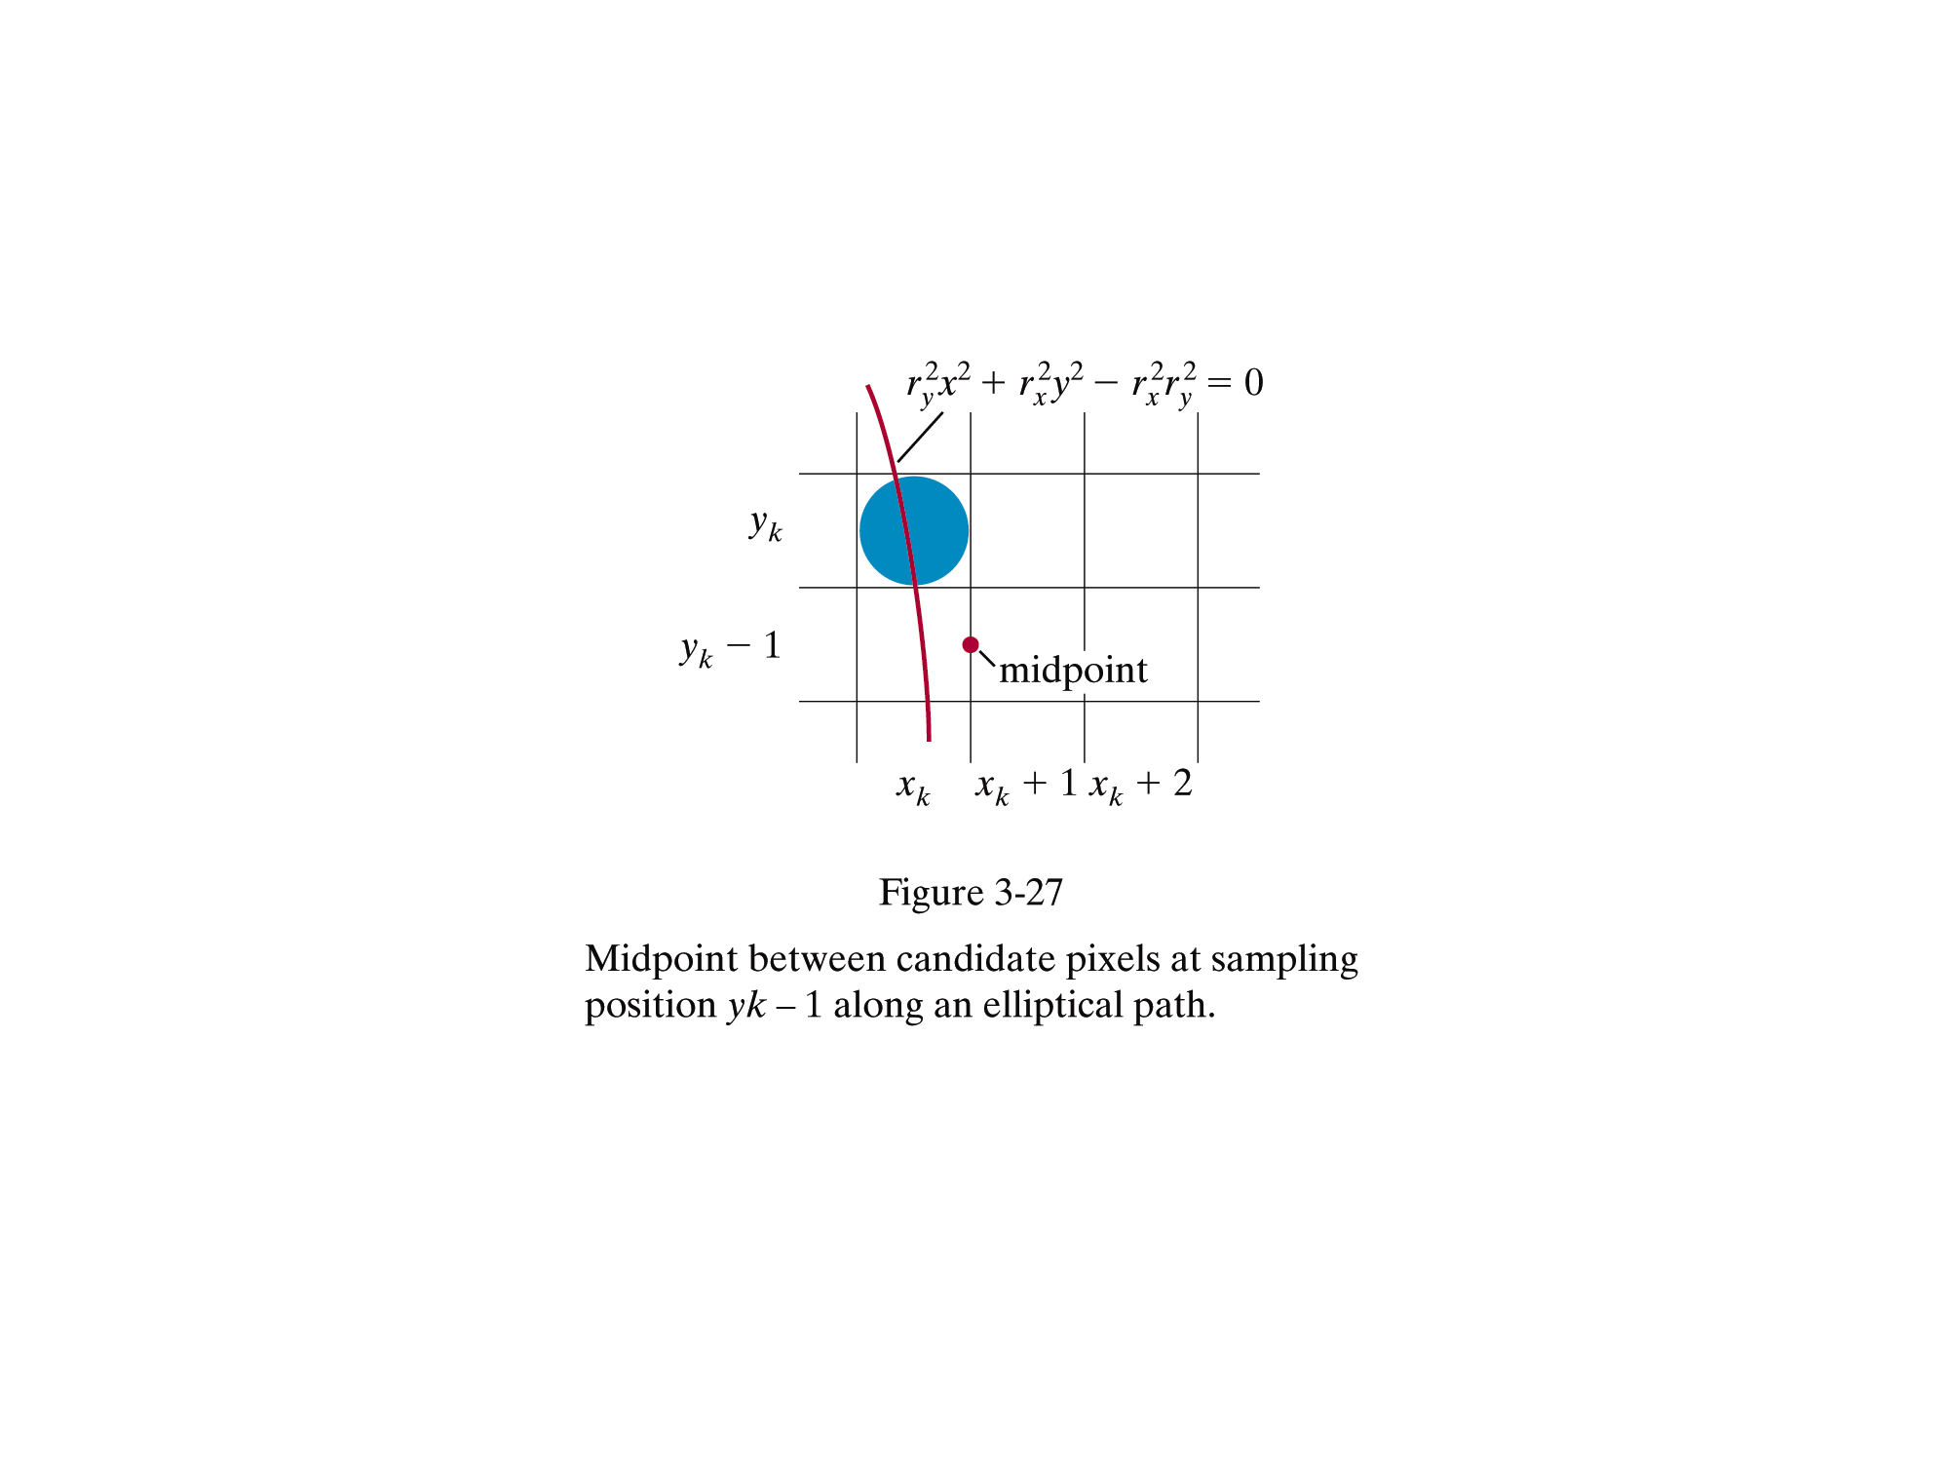

Slide 69
Ellipses
Mid-Point Ellipses Algorithm
. A modification of the mid-point circle algorithm
.. Incremental integer calculations.
. Calculations are easier if:
1. the circle is centered on the origin (0,0)
. points are placed in the correct position by adding x_{c} to the x co-ordinates and y, to the y co-ordinates. ie performing a translation
2. the major and minor axes are aligned to be parallel with x and y axes.
. ellipses are drawn at the correct angle by rotating the points to their correct position.

Slide 70
Ellipses
Mid-Point Ellipses Algorithm
.A decision parameter P is used to determine the y co- ordinate of the next pixel or plot.
. Decision parameter P is based on ellipse function f defined
as f_{ellipse}(x,y) = r²_{y} x² + r²_{x} y² - r²_{x} r²_{y}
that determines whether a pixel is
. inside the ellipse boundary
. on the ellipse boundary
. outside the ellipse boundary.

Slide 71
Ellipses
Mid-Point Ellipses Algorithm
f_{ellipse}(x,y) < 0 if(x,y) is inside the ellipse boundary
= 0 if(x,y) is on the ellipse boundary
> 0 if(x,y) is outside the ellipse boundary.
. Need to divide the quadrant into two regions and process the pixel in each region separately
. In region 1 the ellipse increases faster along the x axis
than y axis.
. In region 2 the ellipse increases faster along the y axis
than x axis.

Slide 72
Ellipses
Mid-Point Ellipses Algorithm
. Region 1:
. Step along the x axis in unit intervals (k) until the
boundary between region 1 and region 2.
. If we have just plotted pixel(x_{k},y_{k),} the choices for the
next pixel to plot are (x_{k} + 1, y_{k} ) and (x_{k} + 1, y_{k} – 1)
. The decision parameter P is the ellipse function
evaluated at the mid-point between these two pixels.
P=f_{ellipse}(x_{k}+1 , y_{k} – 0.5)

Slide 73
Ellipses
Step 1
The initial value of the decision parameter in Region 1 is obtained by evaluating the ellipse equation at the start position (0, r_{y})
p1₀ = r²_{y} –r²_{x}r_{y} + 0.25r²_{x}

Slide 74
Ellipses
Mid-Point Ellipses Algorithm – Region 1
. If P1_{k} < 0
. The mid-point is inside the ellipse boundary so the
pixel at (x_{k} + 1, y_{k)} ) is closer to the ellipse boundary
and should be plotted.
. P1_{k+1} = P1_{k} + 2r²_{y}x_{k+1} + r²_{y}
. If P1_{k}=0 or P1_{k}>0;
. The mid-point is outside or on the ellipse boundary pixel at (x_{k}+1,y_{k}-1) is closer to the ellipse boundary
and should be plotted.
.P1_{k+1} = P1 _{k} + 2r²_{y}x_{k+1} - 2r²_{x}y_{k+1} + r²_{y}
until 2r²_{y}x >= 2r²_{x}y

Slide 75
Ellipses
Mid-Point Ellipses Algorithm
. Region 2:
. Step along the y axis in unit intervals (k) for the
remainder of the curve until y = 0
.If we have just plotted pixel (x_{k},y_{k}), the choices for the
next pixel to plot are (x_{k},y_{k}-1) and (x_{k}+1,y_{k}-1)
.The decision parameter P is the ellipse function
evaluated at the mid-point between these two pixels.
P = f_{ellipse}(x_{k}+0.5 , y_{k} –1)

Slide 76
Ellipses
The initial value of the decision parameter in Region 2 is obtained by evaluating the ellipse equation at the last point (x₀, y₀) in region 1 as
p2₀ = r²_{y} (x₀ +0.5)² + r²_{x} (y₀ -1⁾² - r²_{x} r²_{y}

Slide 77
Ellipses
Mid-Point Ellipses Algorithm – Region 2
. If P2_{k} > 0
. The mid-point is inside the ellipse boundary so the
pixel at (x_{k} , y_{k}-1 ) is closer to the ellipse boundary
and should be plotted.
. P2_{k+1} = P2_{k} - 2r²_{x}y_{k+1} + r²_{x}
. If P2_{k}< 0;
. The mid-point is outside or on the ellipse boundary pixel at (x_{k}+1,y_{k}-1) is closer to the ellipse boundary
and should be plotted.
.P2_{k+1} = P2 _{k} + 2r²_{y}x_{k+1} - 2r²_{x}y_{k+1} + r²_{x}

Slide 78
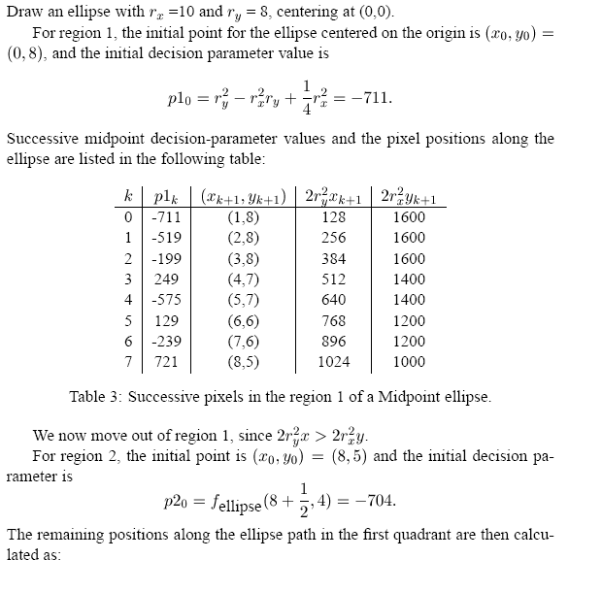

Slide 79
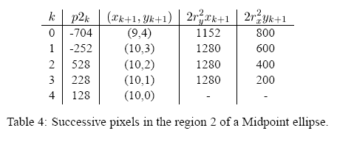

Slide 80
Bresenham’s Mid Point Ellipse Algorithm
inline int round (const float a) { return int (a + 0.5); }
void ellipseMidpoint (int xCenter, int yCenter, int Rx, int Ry)
{
int Rx2 = Rx * Rx;
int Ry2 = Ry * Ry;
int twoRx2 = 2 * Rx2;
int twoRy2 = 2 * Ry2;
int p;
int x = 0;
int y = Ry;
int px = 0;
int py = twoRx2 * y;
void ellipsePlotPoints (int, int, int, int);
/* Plot the initial point in each quadrant. */
ellipsePlotPoints (xCenter, yCenter, x, y);

Slide 81
Bresenham’s Mid Point Ellipse Algorithm
/* Region 1 */
p = round (Ry2 - (Rx2 * Ry) + (0.25 * Rx2));
while (px < py) {
x++;
px += twoRy2;
if (p < 0)
p += Ry2 + px;
else {
y--;
py -= twoRx2;
p += Ry2 + px - py;
}
ellipsePlotPoints (xCenter, yCenter, x, y);
}

Slide 82
Bresenham’s Mid Point Ellipse Algorithm
/* Region 2 */
p = round (Ry2 * (x+0.5) * (x+0.5) + Rx2 * (y-1) * (y-1) - Rx2 * Ry2);
while (y > 0) {
y--;
py -= twoRx2;
if (p > 0)
p += Rx2 - py;
else {
x++;
px += twoRy2;
p += Rx2 - py + px;
}
ellipsePlotPoints (xCenter, yCenter, x, y);
}
}

Slide 83
Bresenham’s Mid Point Ellipse Algorithm
void ellipsePlotPoints (int xCenter, int yCenter, int x, int y);
{
setPixel (xCenter + x, yCenter + y);
setPixel (xCenter - x, yCenter + y);
setPixel (xCenter + x, yCenter - y);
setPixel (xCenter - x, yCenter - y);
}
/* The above procedure accepts values for an ellipse
center position and its semimajor and semiminor axes, then calculates ellipse positions using the midpoint algorithm. */

Slide 84
Fast Ellipses
The circle algorithm can be generalized to work for an ellipse but only four way symmetry can be used.
All the points in one quadrant must be computed. Since Bresenham's algorithm is restricted to only one octant, the computation must occur in two stages. The changeover occurs when the point on the ellipse is reached where the tangent line has a slope of ±1. In the first quadrant, this is when the x and y coordinates are both at 0.707 of their maximum.

Slide 85
Try this
Determine the coordinates of the pixel plotted in the first quadrant for an ellipse with a centre at (0, 0), r_{x} = 8 and r_{y} = 6

Slide 86
Try this
Determine the coordinates of the pixel plotted in the first quadrant for an ellipse with a centre at (10, 8), r_{x} = 8 and r_{y} = 5

Slide 87
Parallel Line Algorithms
. DDA and BRESENHAM determine pixel positions
sequentially and faster with parallel computer
. Line Segmentation Algorithm
. np processors.
. Divide line into np partitions and
assign pixel position calculations of
one segment to one processor.
k is the number of partitions , 0,1,2…upto np -1
((Δx + np -1 )/np) where
Δ Xp =
Δ Xp is partition width
Xk = Xo + k ΔXp (Xk starting X co-ordinate for kth partition )
Δ Yp = m Δ Xp
Yk = Yo +round(k Δ Yp)
(Yk starting Y co-ordinate for kth partition )

Slide 88
Speed Improvement
Parallel Curve Algorithm
. Like straight lines, parallel curve algorithms use segmentation and bounding rectangles.
. Curve segmentation
. Circle
. Divide the circular arc the upper octant into sub-arc segments.
. Assign the pixel calculations for each segment to a different processor.

Slide 89
Speed Improvement
. Ellipse
. Divide the elliptical arc in the first quadrant into sub-arc segment.
. Assign the pixel calculations for each segment to a different processor.

Slide 90
Try this
Given two endpoints of a line are (2,4) and (19, 10) and 4 processors. Based on parallel line segmentation algorithm, determine the endpoints that each processor requires to draw these line segments simultaneously.

Slide 91
Sol
( 2,4) to (19,10) –Line
4 partitions :
(2,4) to (7,6)
(7,6) to (12,8)
(12,8) to (17,9)
(17,9) to (19,10)

Slide 92
Try this
Given two endpoints of a line are (2,4) and (100, 50) and 4 processors. Based on parallel line segmentation algorithm, determine the endpoints that each processor requires to draw these line segments simultaneously.

Slide 93
Filled-Area Primitives
Two ways of area filling on raster system
1. By determining the overlaps intervals for scan lines that cross the area.
2. By starting from interior position outward until specified boundary condition is encountered.

Slide 94
Filled-Area Primitives
. Polygon
- Concave
- Convex

Slide 95
Polygon Classifications
An interior angle of a polygon is an angle inside the polygon boundary formed by two adjacent edges
If all interior angles of a polygon are less than or equal to 180 degree, the polygon is said to be convex
If there is at least one interior angle greater than 180 degree, the polygon is said to be concave
The order of vertices for a polygon can be either clockwise or anti-clockwise

Slide 96
Identifying Concave/Convex
Setup vectors for all edges
Perform cross product to adjacent vectors to test for concavity
Perform dot product if we want to determine the angle between two edges
All vector products will be the same value (positive or negative) for convex polygon
If there are some cross products yield a positive and some yield a negative value, we have a concave polygon

Slide 97
Identifying Concave (cont.)
E_{j}
V_{n}
V6
E5
V5
V_{m}
Ej = (V_{nx} – V_{mx} , V_{ny} – V_{my})
E4
(E1 X E2) > 0
(E2 X E3) > 0
(E3 X E4) < 0
(E4 X E5) > 0
(E5 X E6) > 0
(E6 X E1) > 0
V4
E6
E3
V3
E2
E1
V2
E_{J} X E_{K} = E_{JX}E_{KY} - E_{JY}E_{KX}
V1

Slide 98
Example
Given 6 vertices:
    V1 = (1,1)
    V2 = (5,1)
    V3 = (7,3)
    V4 = (4,5)
    V5 = (4,10)
    V6 = (1,10)
    Prove that these vertices is for concave polygon. What can you say about the cross product values if we change the order of these vertices (v6 becomes v1, v5 becomes v2, etc…).

Slide 99
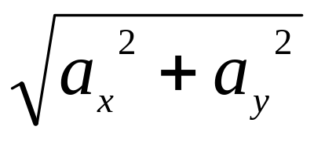
Angle between Edges
Exact angle between two adjacent edges
Use dot product operation
  a.b = |a||b|cos θ
  |a| means the magnitude of vector a
  |a| =
θ

Slide 100
Angle Between Edges
Example:
  Given 2 vectors a = (2,3) and b = (6,3). Determine the angle between these two vectors
  Determine the angle between E3 and E4 (refer to previous example)

Slide 101
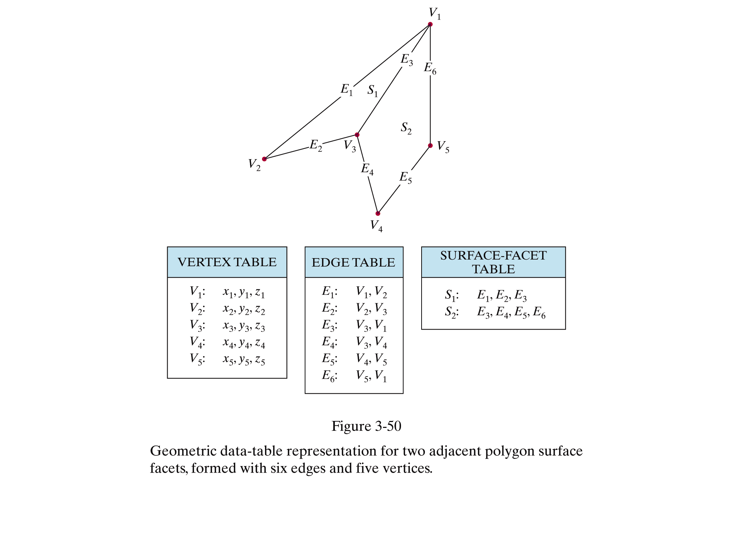

Slide 102
Inside-Outside Tests
. Filling means coloring a region
. How to identify interior or exterior region.
- Once determined only then interior to be filled accordingly.
. Two well known rules which decide the interior or exterior.
. Odd-even rule
. Non-zero winding rule.

Slide 103
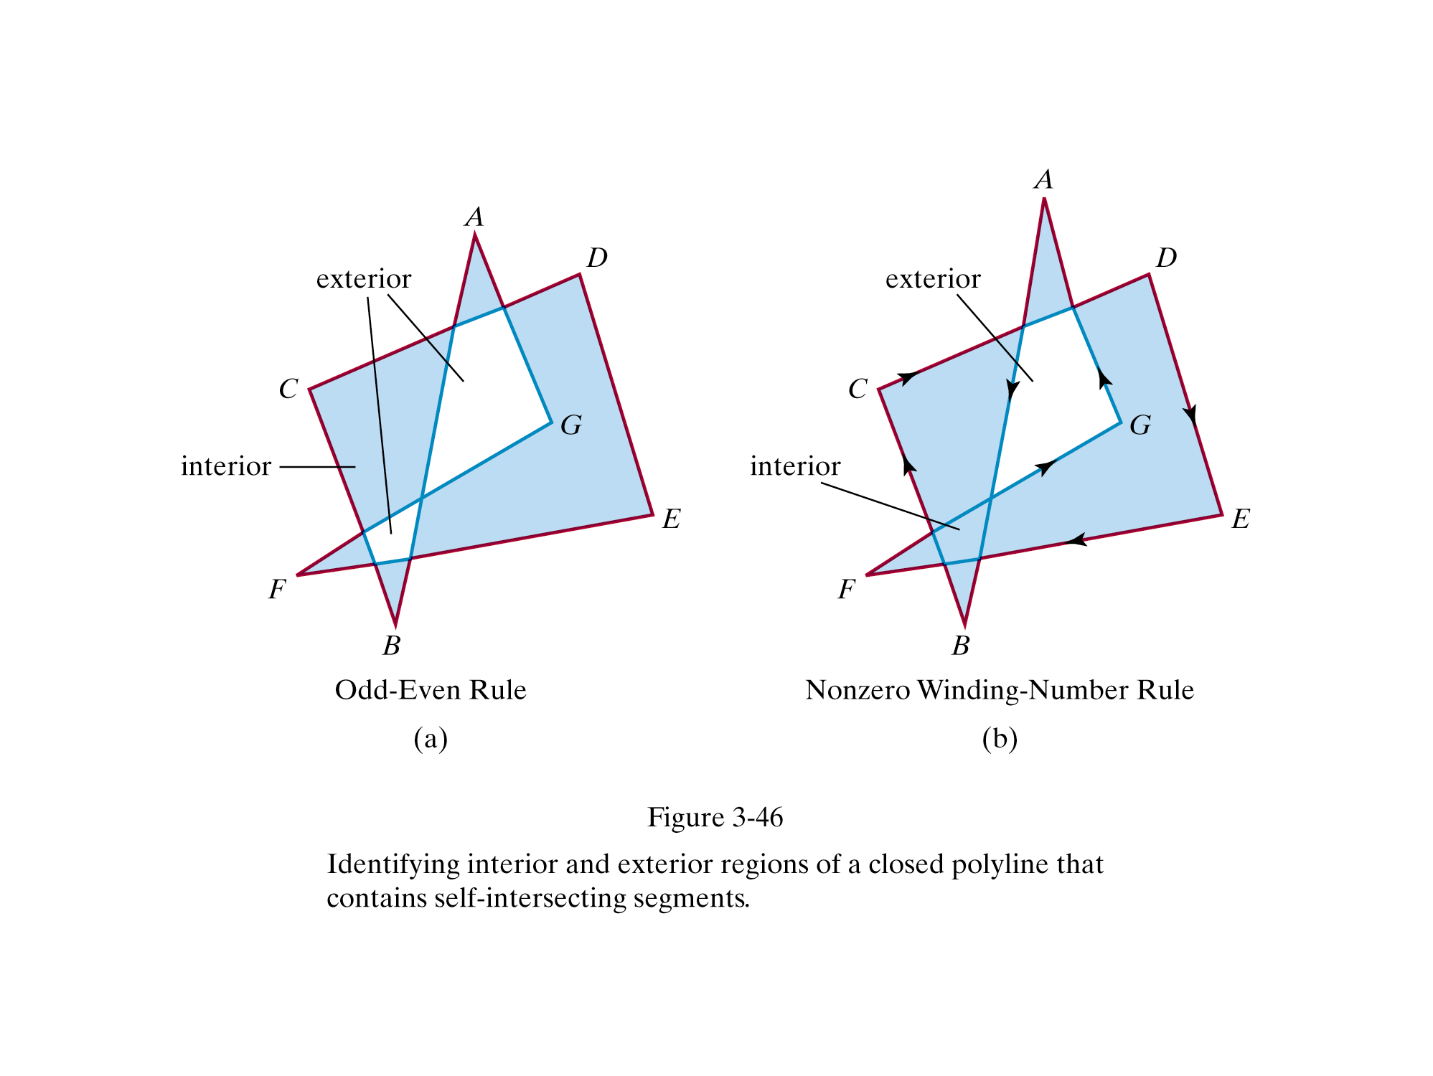

Slide 104
Odd – Even Rule
. Also known as odd-parity and even-odd rule.
.
How it works?
. Pick a point of P in the region of interest.
. Draw a line from P to a distant point which lower than the
smallest x.
. Move from P along the line to the distant point.
. Count the number of region edges the line crosses.
. If the number of crossed is odd then P is inside the interior region
. If the number of crossed is even then P is inside the exterior
region.

Slide 105
Non-Zero Winding Number Rule.
. Each boundary is given a direction number and then sum the numbers.
.
Rules.
. The line chosen must not pass through any vertices.
. If first y values less than second y value
Then give direction number –1.
. If first y values greater than second y value
Then give direction number 1.
. Move from P along the line to the distant point.
. Add or minus based on the direction number when crossing the edges.
. Interior regions have non-zero winding numbers.
. Exterior regions have a winding number of 0.

